Slide 1
Stress & Coping – Part II
Social Support

Slide 2
Reducing the potential for stress by enhancing social support
Social network size is related to prestige, income and education
  Diversity, men vs women
Individual temperaments affect social support
  Supports deteriorate with chronic stress
Children may be taught supportive skills e.g. sharing, talking nicely
Join clubs, organisations etc
Support may be provided by employees in the workplace
Community intervention programs provide support

Slide 3
Psychosocial modifiers - social support.
The perceived comfort, caring, esteem or help received from others.
  the amount of assistance individuals believe is available to them
The existence or quantity of social relationships
  the amount of assistance individuals receive

Slide 4
Perceived Social Support
Assessed based on people’s perceptions of the different types of support various relationships provide
Interpersonal Support Evaluation List – Cohen et al. (1983)
  https://onlinelibrary.wiley.com/doi/pdf/10.1111/j.1559-1816.1983.tb02325.x?casa_token=BAsu7LoB92QAAAAA:IC8fQxznJAvdt2yBXZCCJiO72--3HjopxLF02ZJwc15TKkJ2KM2LShVBojSCNtyrvtIUWwS5hbSqoFL8
  http://www.midss.org/content/interpersonal-support-evaluation-list-isel
  Emotional/Appraisal, belonging, esteem, tangible
Types of Social Support
    Emotional/Appraisal support –expressions of empathy, caring, concern
    Belongingness support
      Ability to talk to others – predicts well-being, decreased levels → increased symptoms

Slide 5
Perceived Social Support
  Types of Social Support (cont.)
    Tangible or instrumental support
      direct assistance, concrete assistance, mobilisation of social support- rule of relative need (those that need help should get it), rule of relative advantage (need is not the only factor)
    Esteem/validation support – affirming self-worth
      expression of positive regard, encouragement, agreement
      heart surgery study – 1 year after surgery with ۸ esteem support from spouses, ۸ emotional well-being, ۷ daily disruptions, ۷ symptoms of heart trouble

Slide 6
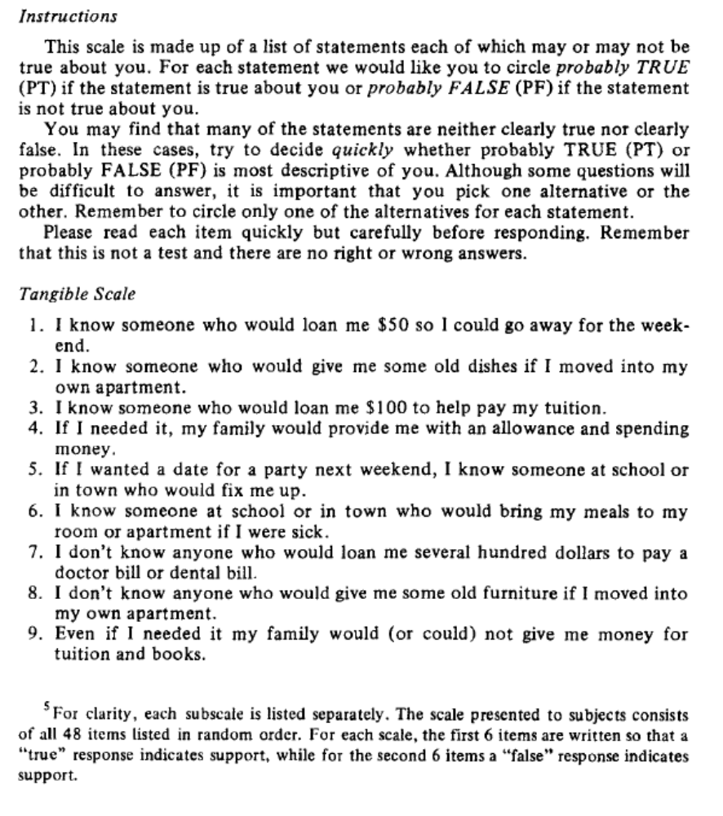
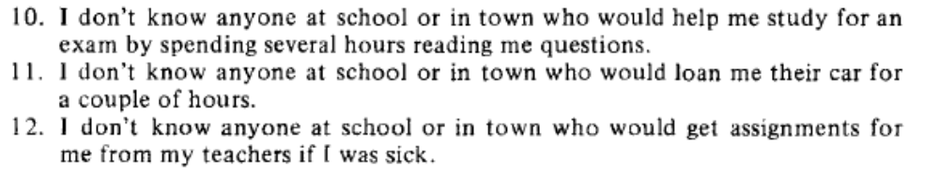
Original scale – Cohen & Hoberman (1983)
https://onlinelibrary.wiley.com/doi/abs/10.1111/j.1559-1816.1983.tb02325.x

Slide 7
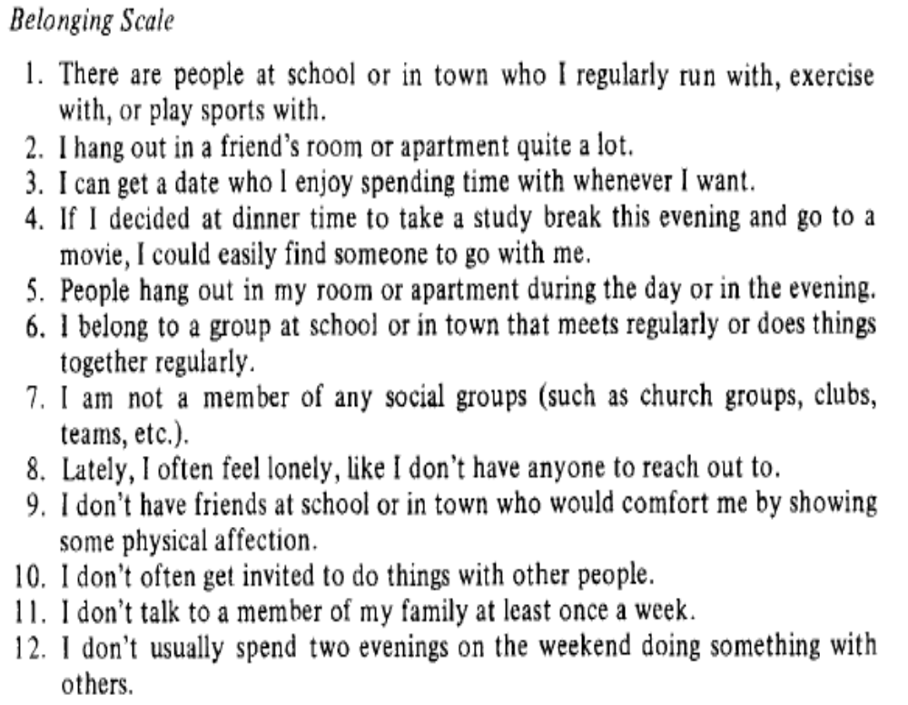
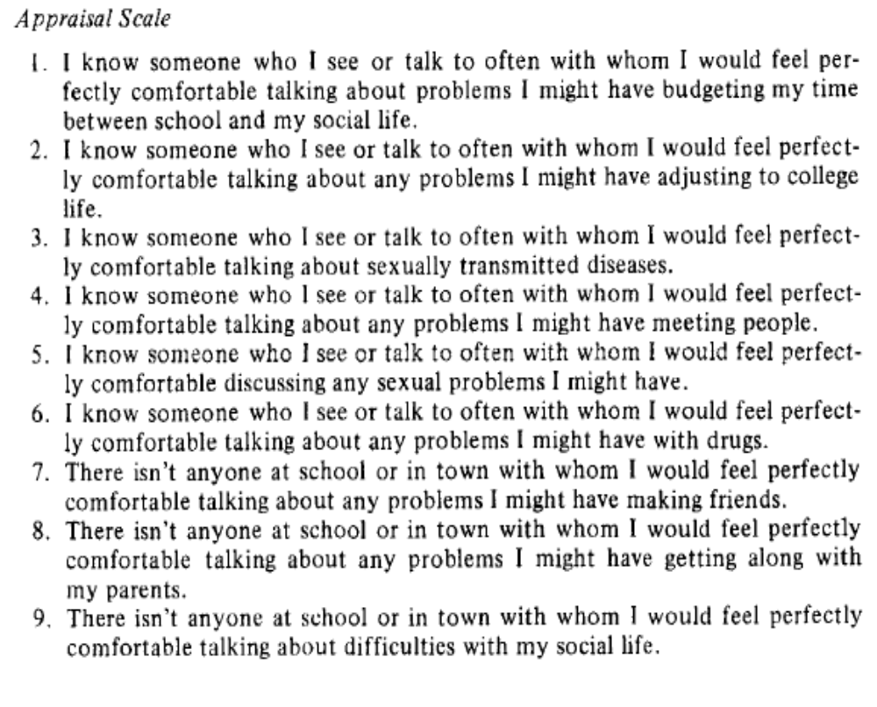
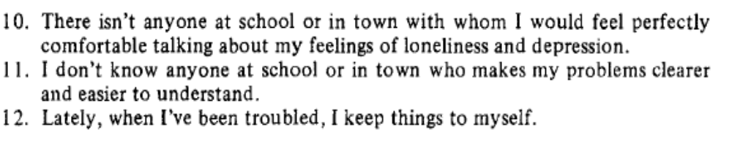
Cont’d

Slide 8
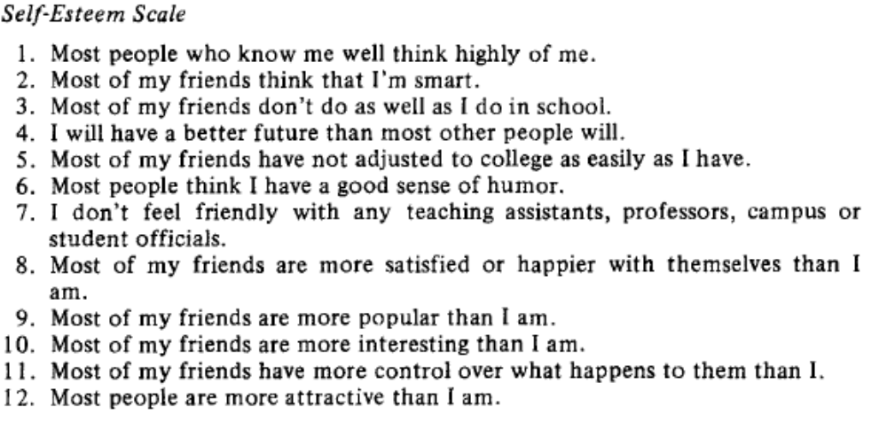
Cont’d

Slide 9
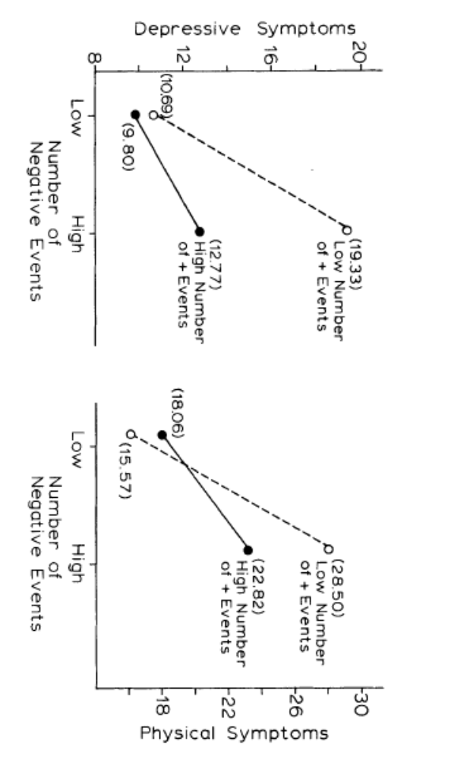
Their initial results… lots of subsequent studies

Slide 10
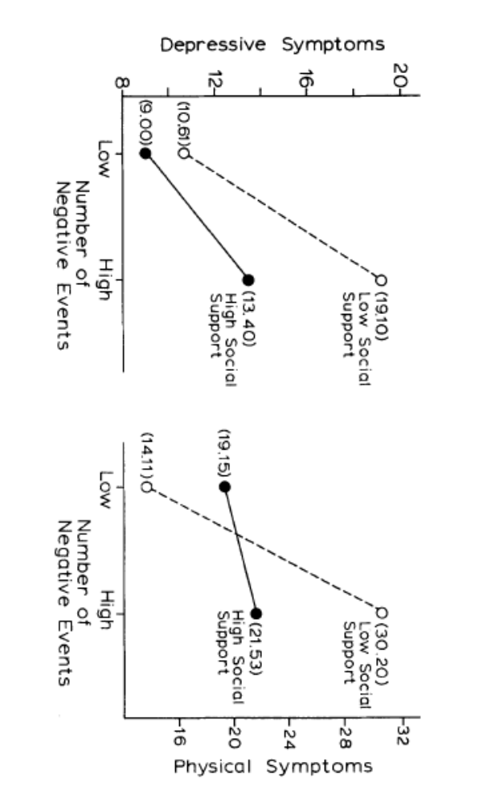
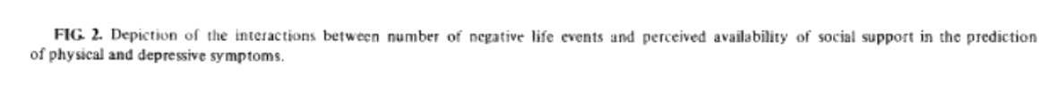
Their initial results… lots of subsequent studies

Slide 11
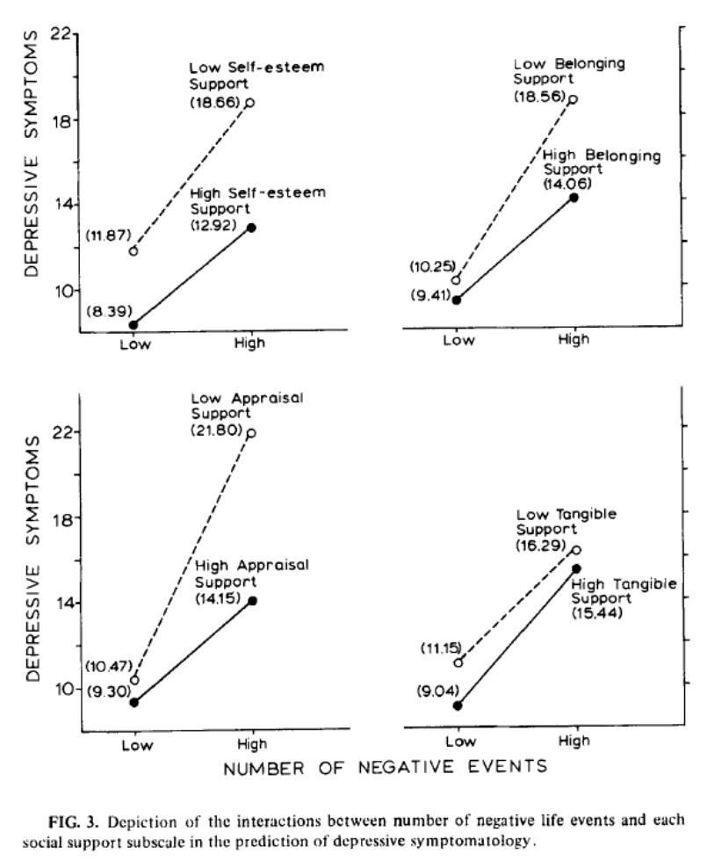
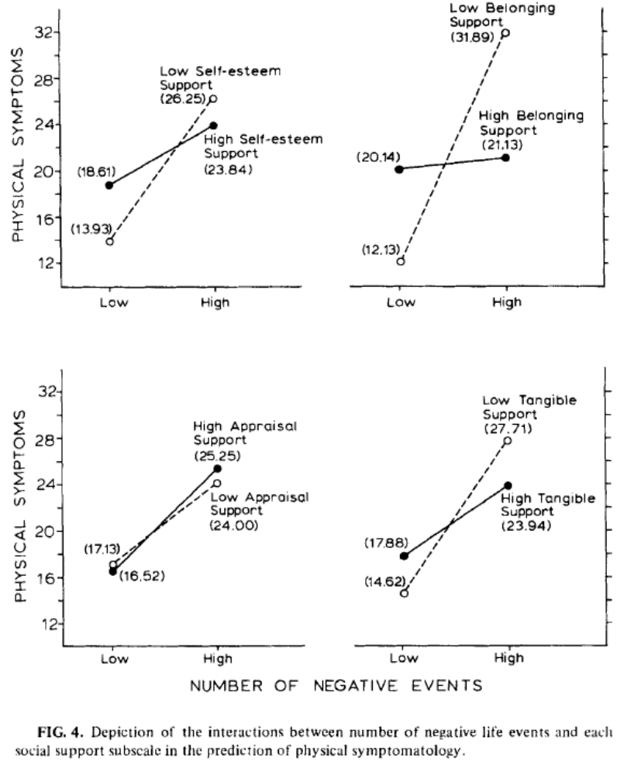
Their initial results… lots of subsequent studies

Slide 12
Social Support
Most frequent forms of social support
  Type of support received often depends on the circumstances.
    Tend to receive more forms of support during stressful situations.
    Emotional, informational, and esteem support occurred more frequently than tangible support.
    Esteem support was associated with less depression

Slide 13
Received social support
Perceptions of social support more important than actual availability of support
  A sweeping generalisation, naturally
Assessed based on the amount of support received in a particular period of time – Inventory of Socially Supportive Behaviours – how often in the past 4 weeks received supportive behaviours – Barrera et al. (1981)
http://www.midss.org/content/inventory-socially-supportive-behaviors-issb-long-and-short-form

Slide 14
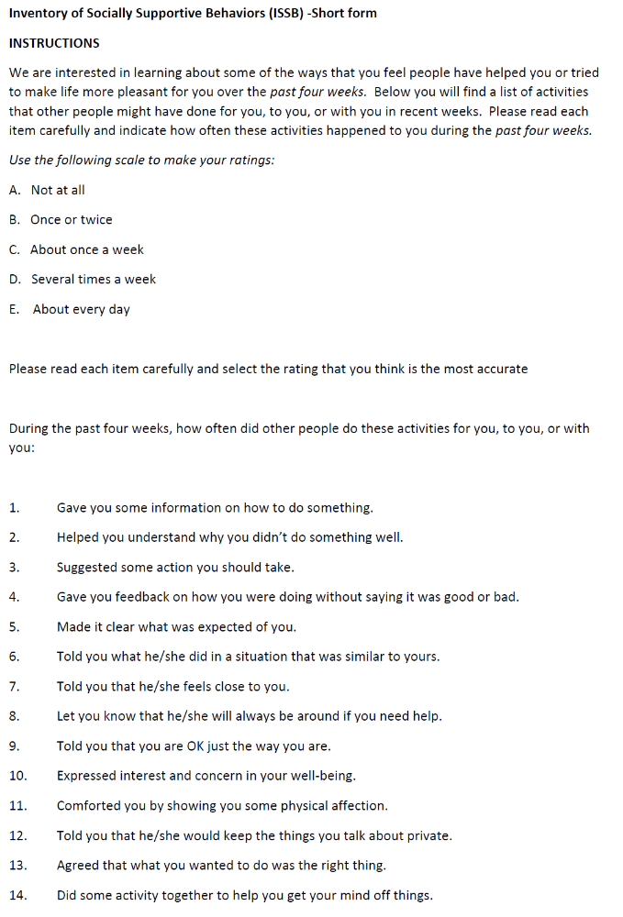
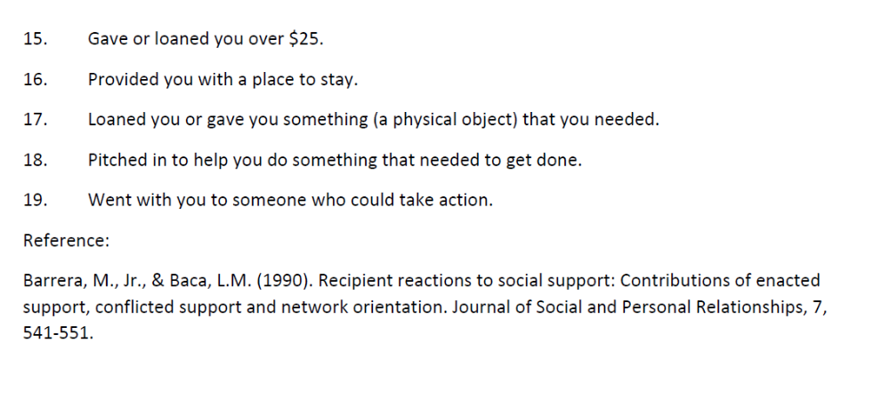
Short form…

Slide 15
ISSB
Long form has good psychometric properties, and relates well to stress, distress etc
But, some problems
  the amount of support received is correlated with negative health symptoms
  the available support may have not been needed during the assessment period
  there is often little or no association between actual and perceived support

Slide 16
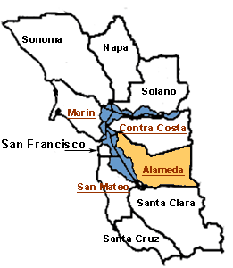
What is the link between social support and health?
Alameda County, California Study – Berkman and Syme (1979)
  Link to paper
  7000 men and women studied in 1965
  Index based on four types of social ties: marital status, number contacts with friends and relatives, and church and group membership
  Persons with low scores (lack of social ties) had 9-year mortality rates 1.9 to 3 times greater than those with high scores (more social ties)
  Results have been replicated in U.S. and Europe
Assoc with mortality independent of self-reported physical health, year of death, socioeconomic status, smoking, alcohol use, obesity, physical activity, utilisation of preventative health services, and cumulative index of health practices.

Slide 17
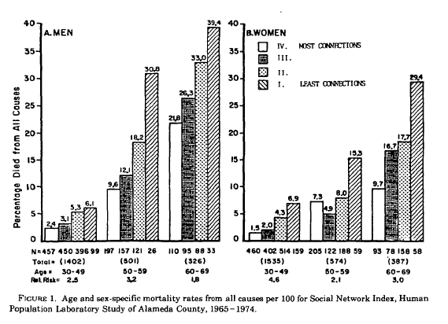
What is the link between social support and health?

Slide 18
Psychological well-being and Social Support
More social support – higher psychological well-being
  Depressed persons have lower social support
Found in U.S. and Japanese studies of older adults: more social support lower depression rates and fewer neurotic symptoms
Longitudinal studies
  less likely to be depressed 1 year later- HIV+ gay men – Hays et al. (1992)
  less likely to display anxiety – chronic disease – Sherbourne & Hays (1990)
  College students less likely to visit campus infirmary – Reis et al. (1985)

Slide 19
Physical Well-Being and Social Support (SS)
Associated with lower coronary heart risks – study of 3809 Japanese-American males – Berkman (1985)
Associated with lower levels of PSA (a marker of prostate cancer) – Stone et al. (1999)
Impact on health of having low levels of SS is similar in magnitude to the effects of smoking – House et al. (1988)
With women, higher SS associated with fewer pregnancy complications, heavier and healthier babies, and lower rates of postpartum depression
Shorter period of labour – experimental study – “supportive lay women” - High SS: 8.7 hrs. Low SS 19.3 hrs. – Sosa et al. (1980)

Slide 20
Rapid Recovery from Illness
Lower pain levels
Kulik & Mahler (1989) – spousal support study of recovery from heart bypass surgery –
  56 males, measure quality of marriage (High or Low) and anxiety level, amount of SS was number of visits by wife. Comparison group was 19 unmarried patients (tracked non-spouse visits – there were few - treated as distinct, but essentially low SS).
  High SS had faster recovery, less pain medication
  High SS released 1.26 days sooner than low SS, and 0.58 days earlier than single
  Non-supportive marriage seemed to have a negative impact on recovery
  Perceived marital quality no effect… but little variation
Associated with quicker recoveries from illnesses
Associated with lower likelihood of returning to hospital following heart surgery

Slide 21
But are these effects correlation or causation?
Virtually all research is correlational!
Possible explanations
  A) illness leads to disruption in social support
    After initial increase, perhaps?
  B) third variable causes the association
Alternative Explanations Unlikely
  longitudinal studies still show an association between social support and rates of mortality
  studies still show link when taking other variables into account such as socioeconomic status and personality

Slide 22
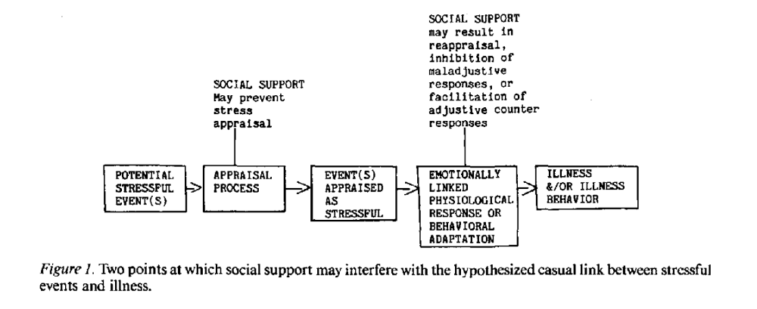
When does social support lead to better health?
Buffering hypothesis (Cohen & Wills, 1985): suggests that SS leads to better health by protecting people from the negative effects of high stress, and hence SS is particularly beneficial during stressful times
  numerous studies suggest SS is particularly beneficial in terms of health for people undergoing high levels of stress: military in combat, AIDS patients, persons experiencing natural disasters
SS allows people to think about difficult situations more positively
(Tangible) SS allows people to cope more effectively – Peirce et al. (1996)
  Financial stress study – more tangible SS lower levels of drinking – but not appraisal nor belonging – consistently, anyway
From Cohen & Wills (1985)

Slide 23
When does social support lead to better health (cont.)?
Direct (main) effects hypothesis: posits that SS can help people at both low and high levels of stress, and hence having high levels of SS is always advantageous to health
Social relationships could influence their attitudes and behaviours related to health – like wearing seatbelts
  encourage others to exercise, stop smoking, eat balanced diet
Absence of social relationships → loneliness
Rook (1987) – studied effects of companionship on health, SS measured, social companionship measured. SS assisted people in the time of stress (buffering) and social companionship led to positive well-being regardless of stress levels

Slide 24
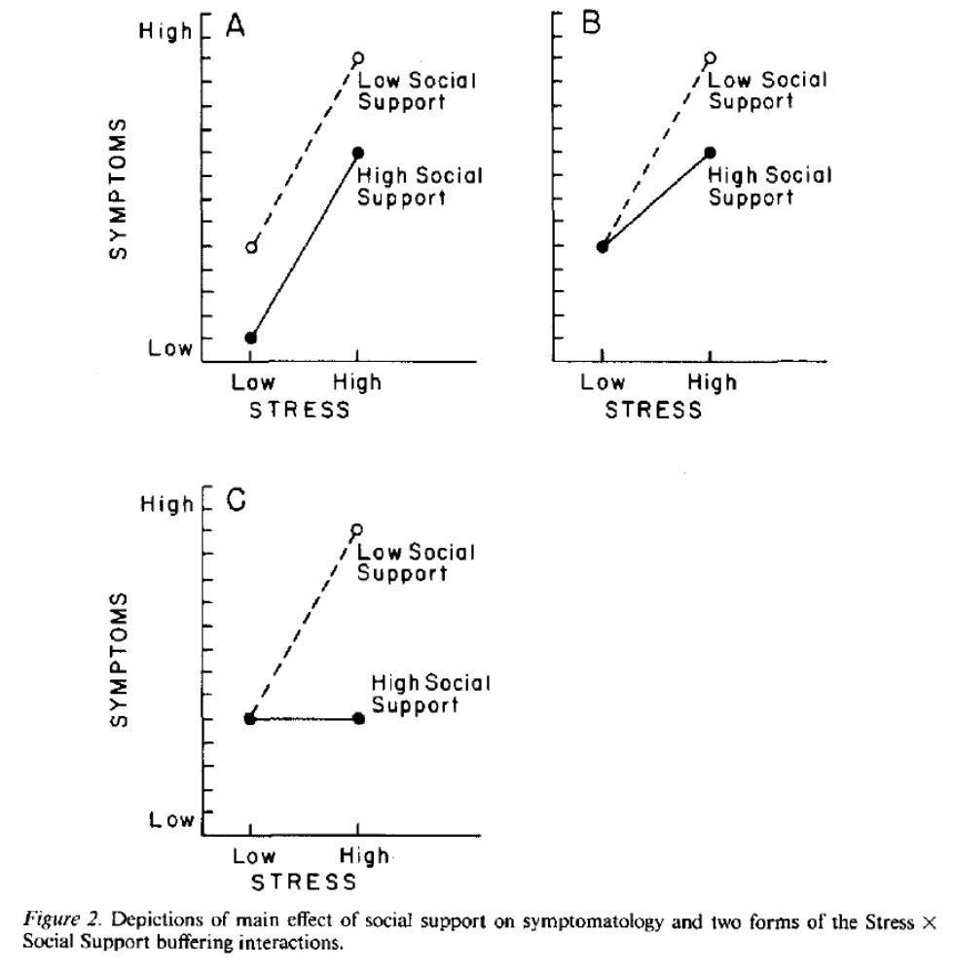
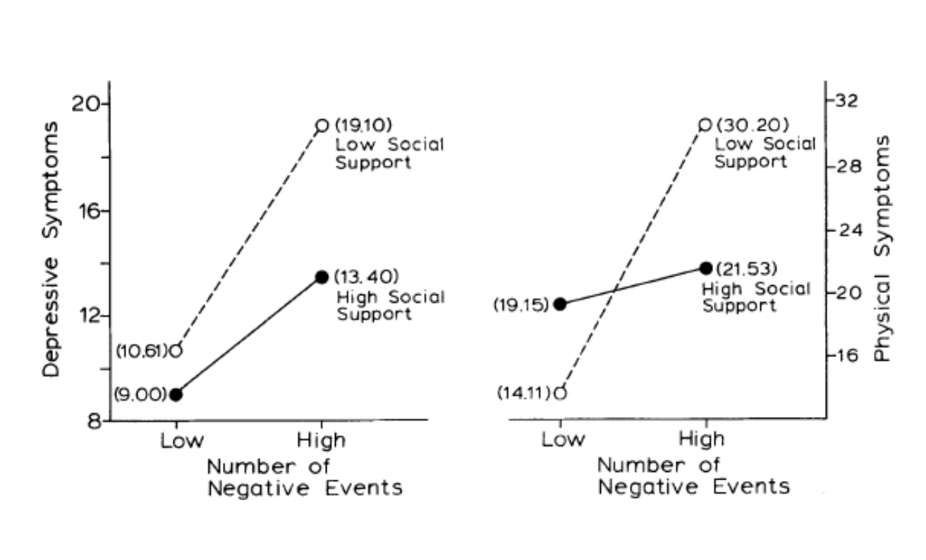

A – Direct effect – consistent effect
B – Buffering – partial amelioration
C – Buffering – complete amelioration
From Cohen & Hoberman (1983)

Slide 25
Who benefits from what support?
People in different situations benefit from having different types of support – matching hypothesis – depends on type of problem
  in the case of ‘controllable’ events (e.g., new parents, victims of natural disaster, breakdown), people benefit from practical support.
  in the case of uncontrollable events (e.g., loss of spouse), people benefit from emotional support.
  Receiving social support from persons with similar problem has benefits – Kulik et al. (1996) – matching hospital roommates who had heart surgery, lower anxiety, more mobile post op, left hospital earlier: 8.04 days v. 9.17 days for those patients who did not have roommates who previously had the surgery

Slide 26
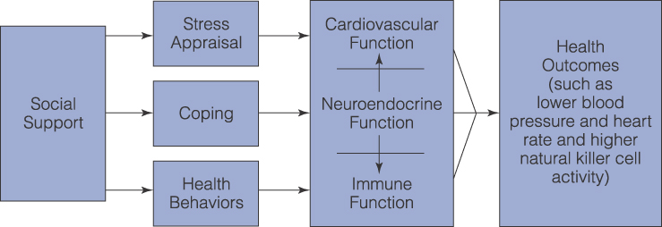
How does social support lead to better health?

